Slide 1

Data Types and Structures in R
Session 16

Slide 2
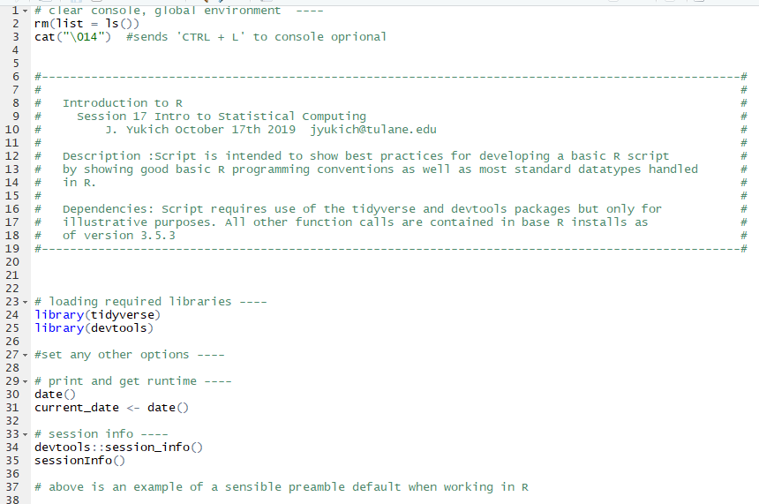
Preamble
Sections –
Cleaning environment and console
Description – including description and dependencies
Loading of required libraries
Other options
Print date and store runtime
Print session info
Nest step is any user defined functions for this script
We’ll investigate these in more detail later.
Note here specifics of formatting # text ---- creates foldable sections

Slide 3
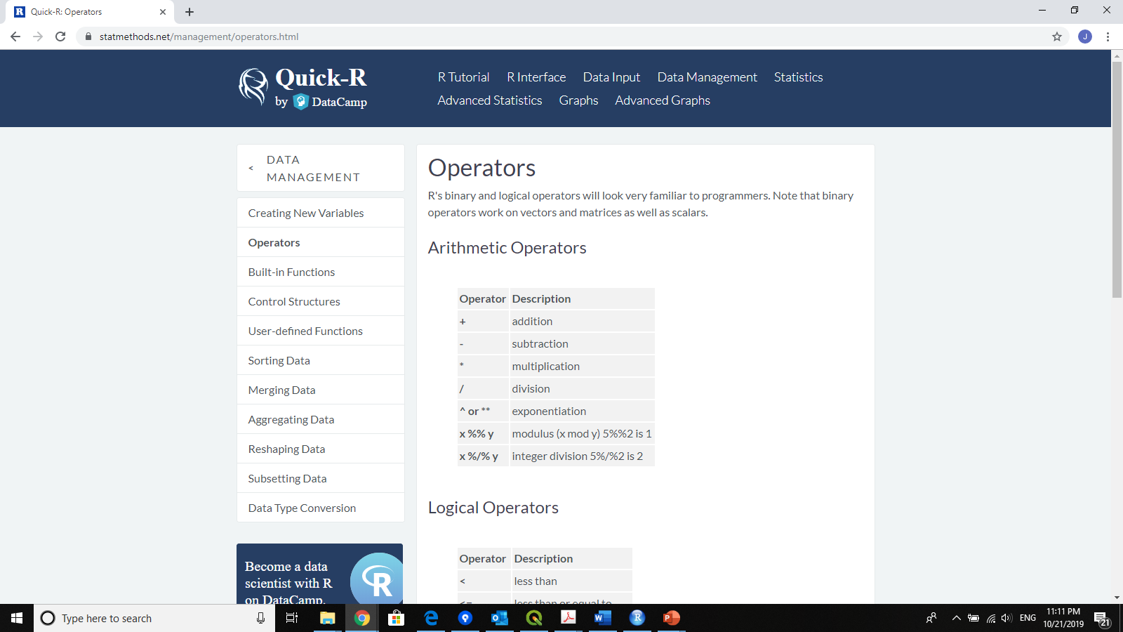
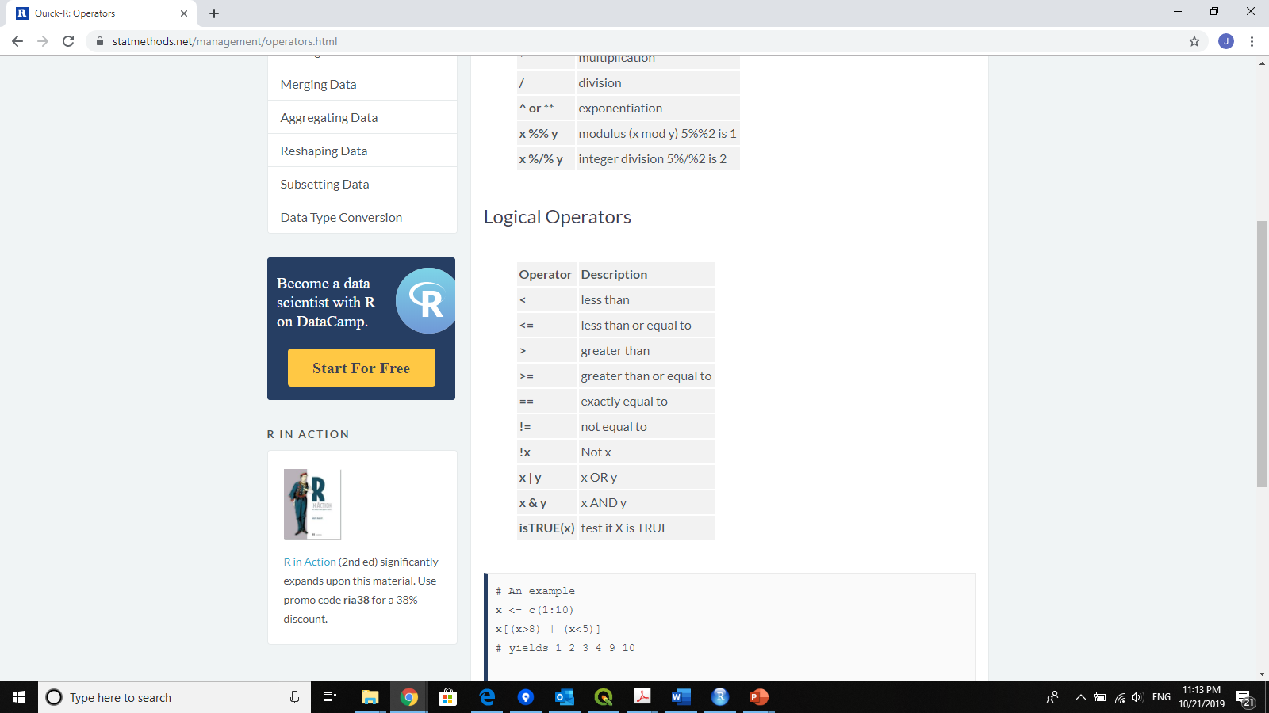
Operators and Assignment
Assignment in R
Best practices is to use ‘<-’
= single equals sign also works.
Always assign left to right:
X <- 42
Read the above as “X takes the value 42”

Slide 4
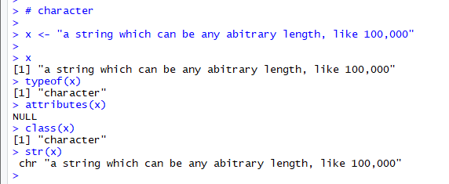
Data types
Character
Numeric
Integer
Logical
Complex
Strings

Slide 5
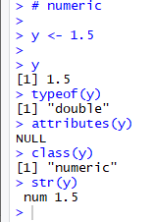
Data types
Character
Numeric
Integer
Logical
Complex
Floating point numeric values

Slide 6
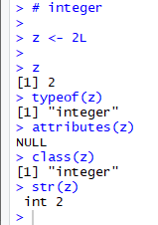
Data types
Character
Numeric
Integer
Logical
Complex
Note the L following the number in initial variable creation

Slide 7
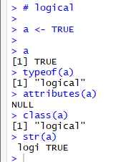
Data types
Character
Numeric
Integer
Logical
Complex
TRUE or FALSE
Can also contain NA - not available.

Slide 8
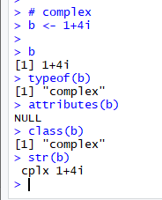
Data types
Character
Numeric
Integer
Logical
Complex
Real and imaginary parts.
We wont use these here, nor will we use ‘raw’ R’s sixth datatype

Slide 9
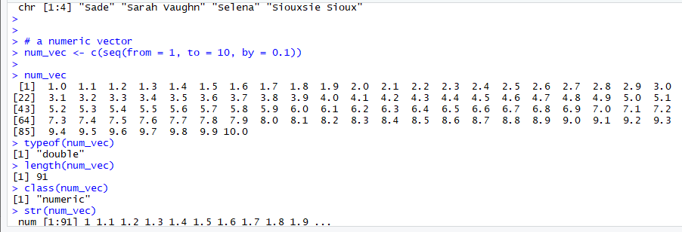
DATA STRUCTURES
Atomic Vectors
Lists
Matricies
Data.frames
Factors
One dimensional
Can hold only one data type
Created in a number of ways, but c() function is very common
IF you try to c() more than one data type R will try to find a datatype that can hold all entries.

Slide 10
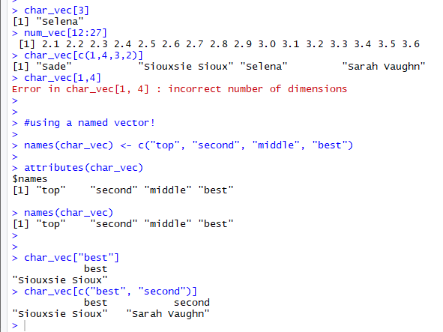
DATA STRUCTURES
Atomic Vectors
Lists
Matricies
Data.frames
Factors
Sub-setting vectors ‘[‘ function.

Slide 11
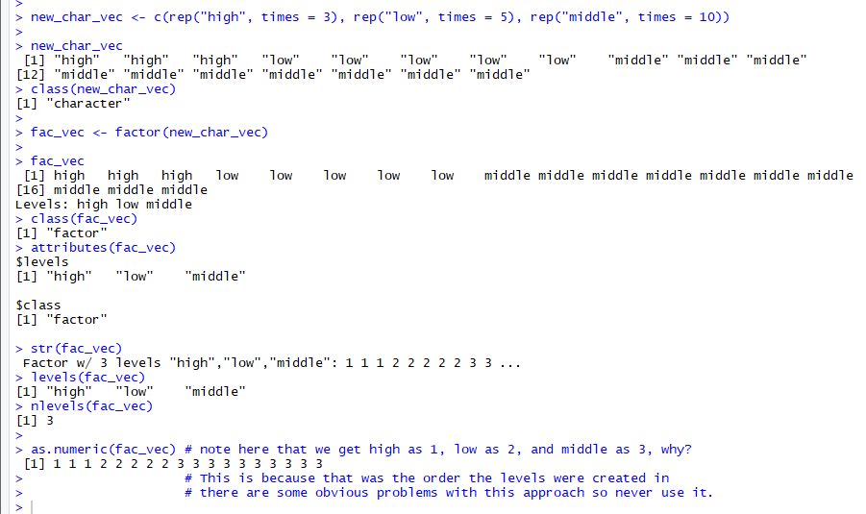
An Interlude for FACTORS
Called categorical or class variables in other statistical programing languages.
Store character data but only with a limited number of categories. Underlying them are numeric codes. Similar to STATA.
Have attributes known as ‘levels’

Slide 12
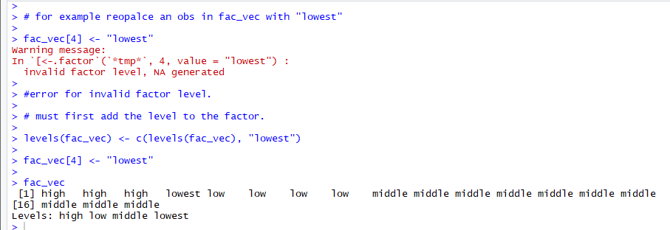
An Interlude for FACTORS
Adding levels to factors
Can’t add data to factor vectors unless a matching level already exists
First must add the level to the factor vector, then add level.

Slide 13
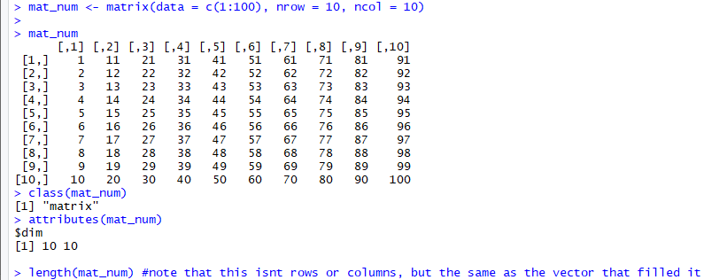
DATA STRUCTURES
Atomic Vectors
Lists
Matricies
Data.frames
Factors
two dimensional – can be expanded as arrays to higher dimensions
Can hold only one data type
Created in a number of ways, but matrix(…, nrow = , ncol =) function is very common
IF you try to combine more than one data type R will try to find a datatype that can hold all entries.
Technically a matrix is a atomic vector with a dim() attribute.

Slide 14
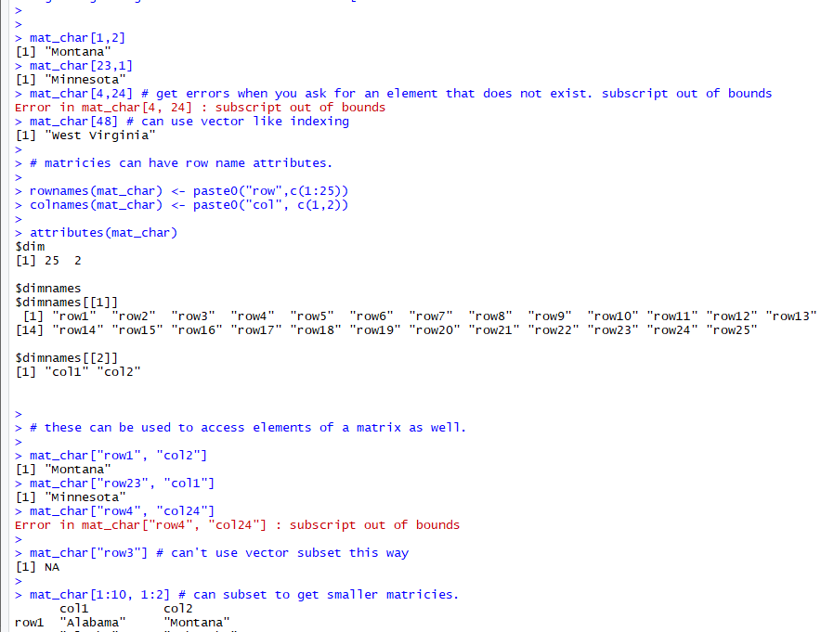
DATA STRUCTURES
Atomic Vectors
Lists
Matricies
Data.frames
Factors
Indexing/subsetting not unlike vectors but requires thinking in two dimensions
Can also have row and column names attributes which can be used.

Slide 15
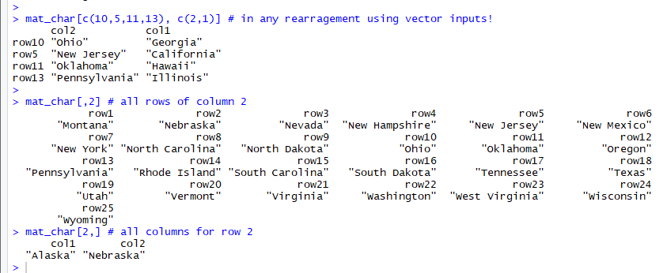
DATA STRUCTURES
Atomic Vectors
Lists
Matricies
Data.frames
Factors
Leaving one dimension empty returns all elements in that direction (e.g. all rows or all columns)
Sub-setting and indexing (like for almost all objects) can be used to rearrange, drop rows or columns.

Slide 16
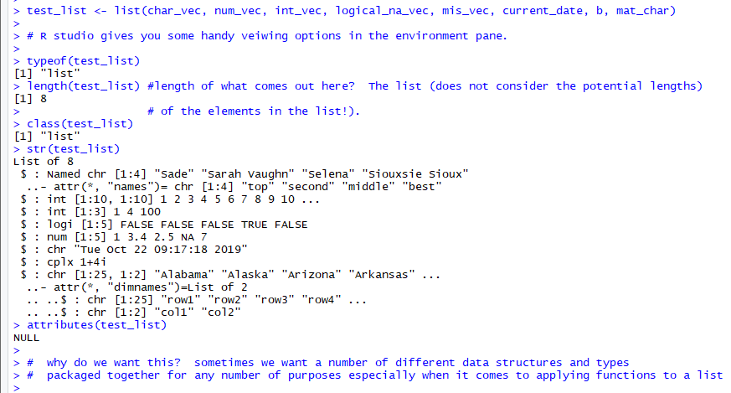

DATA STRUCTURES
Atomic Vectors
Lists
Matricies
Data.frames
Factors
Lists are also ‘one-dimensional’. Like vectors. But can hold a mix of datatypes and structures (anything really)
Can also have a names attribute, creating a named list.
Viewing these in R studio can be helpful using the environment pane

Slide 17
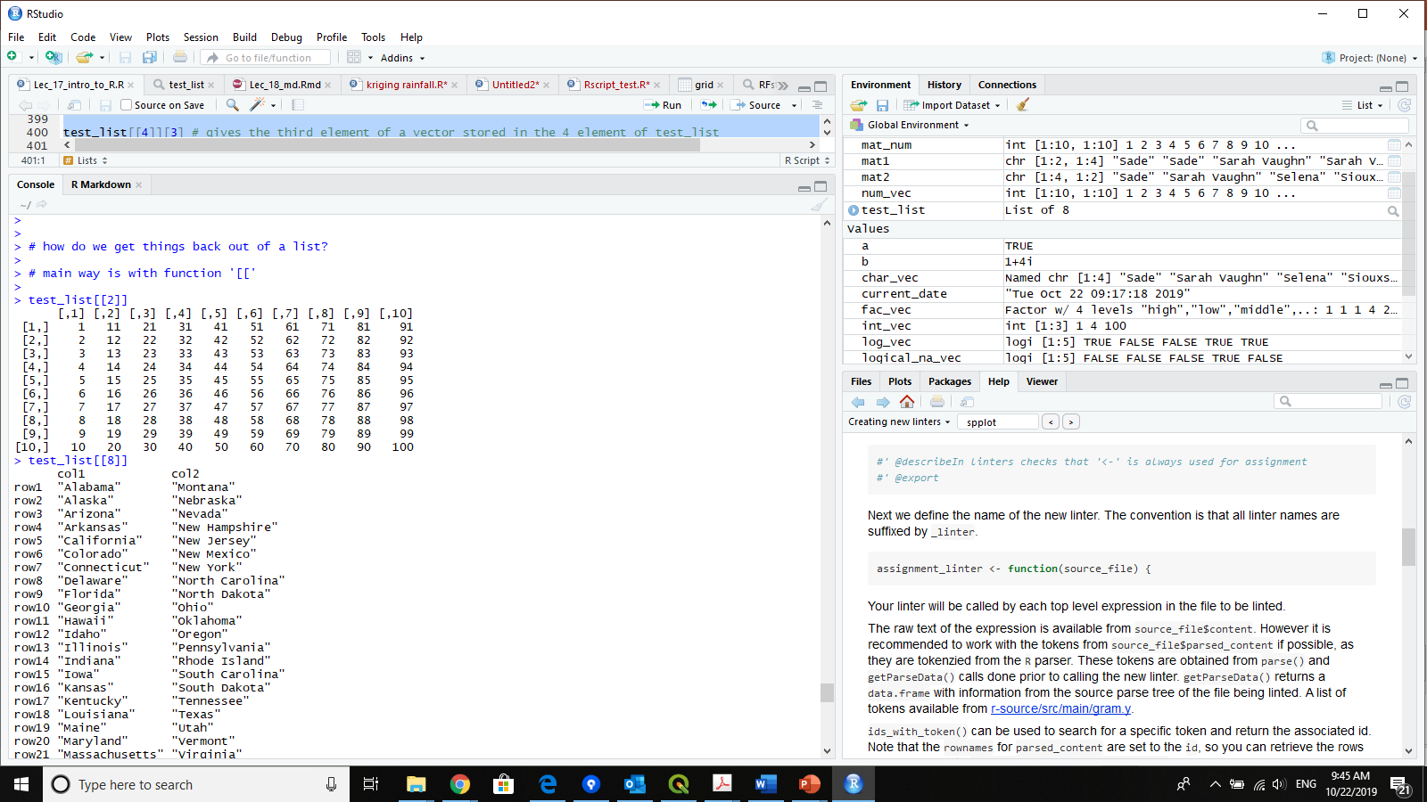
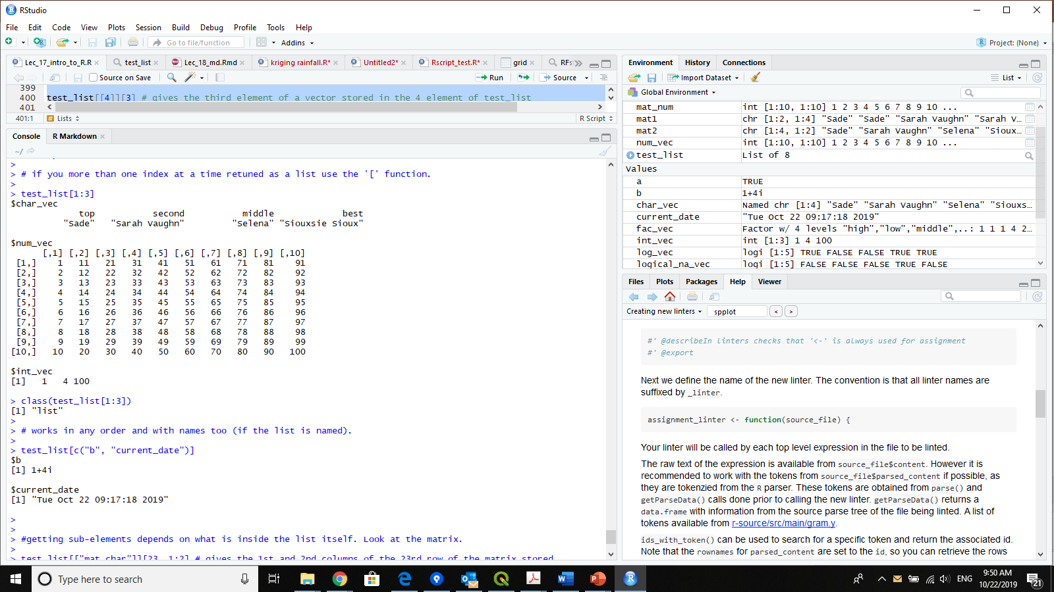
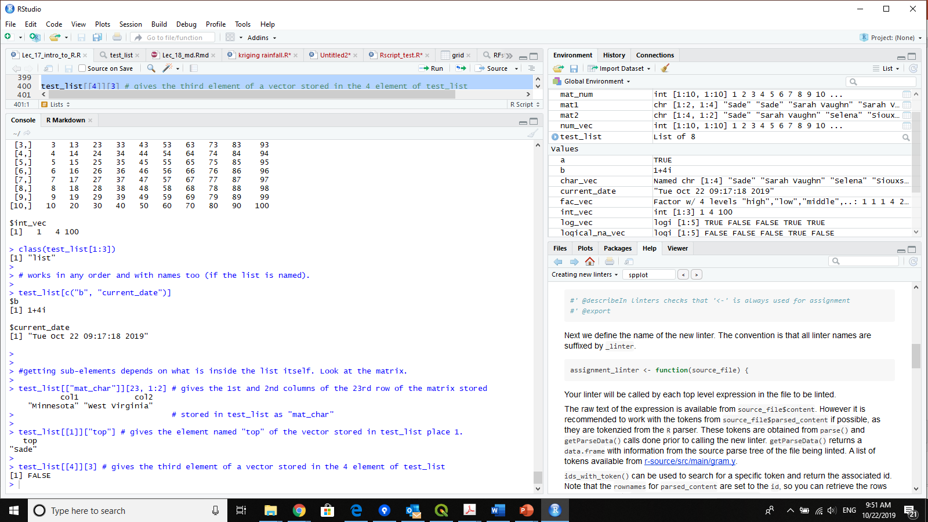
DATA STRUCTURES
Atomic Vectors
Lists
Matricies
Data.frames
Factors
‘[[‘ function is most common indexing tool for lists.
https://cran.r-project.org/doc/manuals/R-lang.html#Indexing gives some details about this and indexing in general in R
Can also use ‘$’ – more on this in data.frames

Slide 18
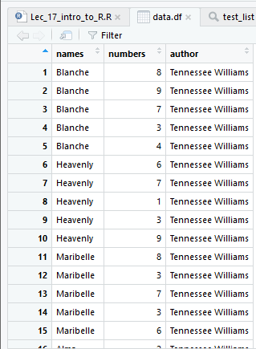
DATA STRUCTURES
Atomic Vectors
Lists
Matricies
Data.frames
Factors
Data.frame is R’s data structure that most resembles a STATA dataset or a SAS data set.
Think rows, columns, with observations typically in Rows and variables typically in columns.
Technically R’s data.frame is a named list, where each element of the list is a vector and all these vectors must be the same length.
This means it is a rectangular list, and that each element of the list can hold only one datatype.

Slide 19
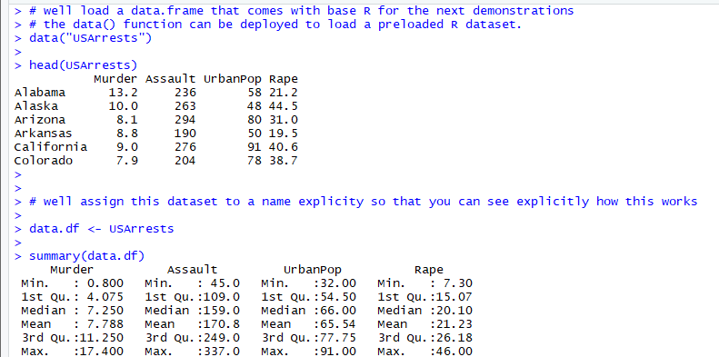
DATA STRUCTURES
Atomic Vectors
Lists
Matricies
Data.frames
Factors
The data.frame(..., row.names = NULL, check.rows = FALSE, check.names = TRUE, fix.empty.names = TRUE, stringsAsFactors = default.stringsAsFactors()) function is one of the most common ways to create these
But also commonly made by functions that load data from files
The data() can be used to load R’s built in datasets.
Assigned like any other object

Slide 20
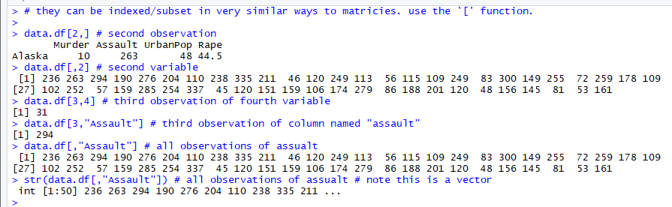
DATA STRUCTURES
Atomic Vectors
Lists
Matricies
Data.frames
Factors
Accessing and using info in data frames
Matrix type approach works using ‘[‘ – remember 2 dimensions

Slide 21
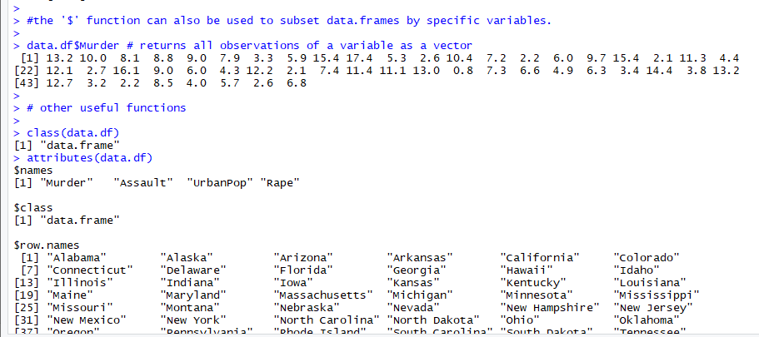
DATA STRUCTURES
Atomic Vectors
Lists
Matricies
Data.frames
Factors
Accessing and using info in data frames
The ‘$’ function also will identify variables by character string or symbolic name and return all observations as a vector.
Data frames have attributes including names (column), class and sometimes row names.

Slide 22
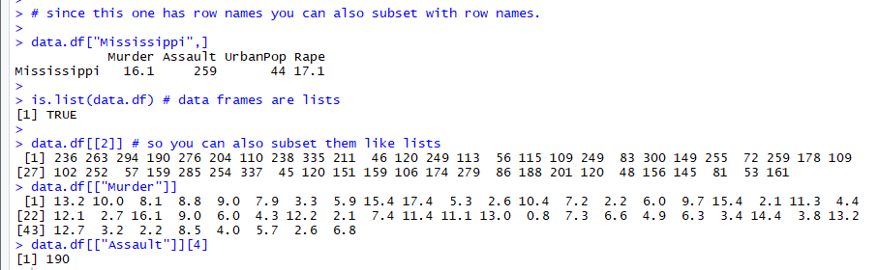
DATA STRUCTURES
Atomic Vectors
Lists
Matricies
Data.frames
Factors
Accessing and using info in data frames
Since they are lists, they can be subset/indexed like lists as well.
Generally you will see objects often subset using numeric indices.
We must be very careful here, similarly to using OBS = XXX SAS or IN XXX in STATA the numeric index can easily be misaligned if the object gets sorted in different order.
Where possible subsetting and indexing via names is generally more ‘reproducible’, ‘transferable’ and readable by humans.

Slide 23
A Final Note on Missing DAta
R’s native missing designation is NA.
Stands for not available.
You will obviously encounter similar problems when encountering 99 or other types of missing codes as in SAS, STATA etc…
The is.na() function is critical for testing if data is missing, it returns a logical value ‘TRUE or FALSE’ if a data element is NA.
Frequently functions have a ‘na.rm = logical’ argument, which is needed to tell the function how to handle missing data.
Well deal with this in cleaning and summarizing data more.
NA is not the same as NaN which is ‘Not a Number’ and results when you try (for instance) to divide by Zero or do other mathematical operations that return nonsense.
NA
NaN

